Slide 1
Study Buddy: Smart Study Companion
Bridging AI and Education
Developing an Interactive Study Assistant

Slide 2
Introduction
AI is transforming education by providing personalized learning experiences.
Many students struggle with complex topics, leading to decreased retention.
The Study Buddy aims to simplify learning, provide reminders, quizzes, and track progress.

Slide 3
Background of the Study
AI-powered learning tools enhance engagement and academic performance.
Studies show that intelligent tutoring systems provide personalized recommendations.
Despite accessibility concerns, AI-driven education is becoming more inclusive.

Slide 4
Objectives
- Help students who struggle with traditional learning techniques.
- Create a personalized learning experience through adaptive quizzes.
- Enhance engagement and knowledge retention using user feedback.

Slide 5
Problem Statement
- The fast-paced academic system can lead to information overload.
- Traditional study methods are not suitable for all students.
- Many e-learning platforms lack personalized study plans, affecting retention.

Slide 6
Proposed Solution
The AI-powered Study Buddy will:
- Simplify complex subjects.
- Provide reminders and quizzes.
- Adapt study plans based on student progress.
- Use HCI principles for an intuitive learning experience.

Slide 7
System Design
- AI-driven chatbot for answering queries.
- Progress tracking and adaptive learning techniques.
- Interactive quizzes and study reminders.

Slide 8
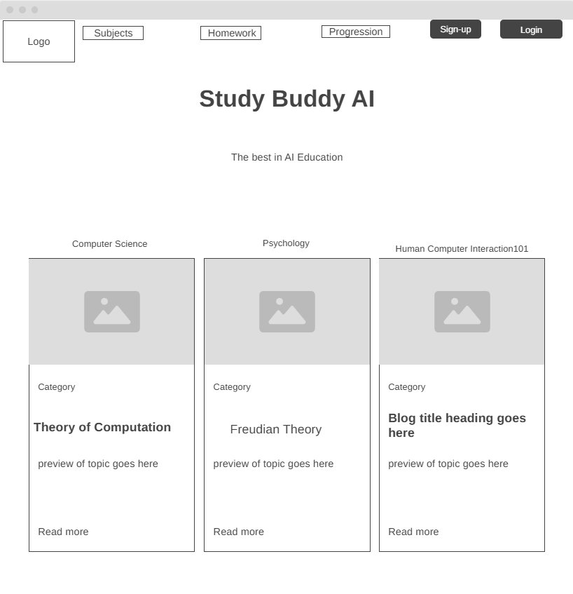

Slide 9
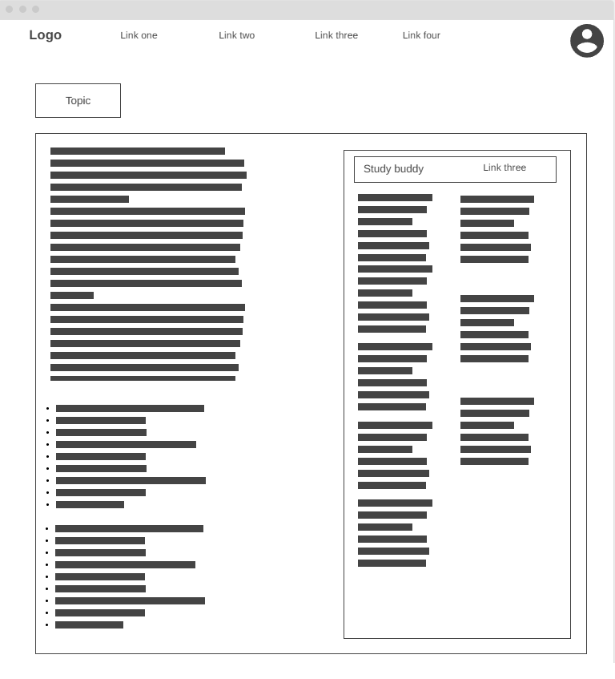

Slide 10


Slide 11
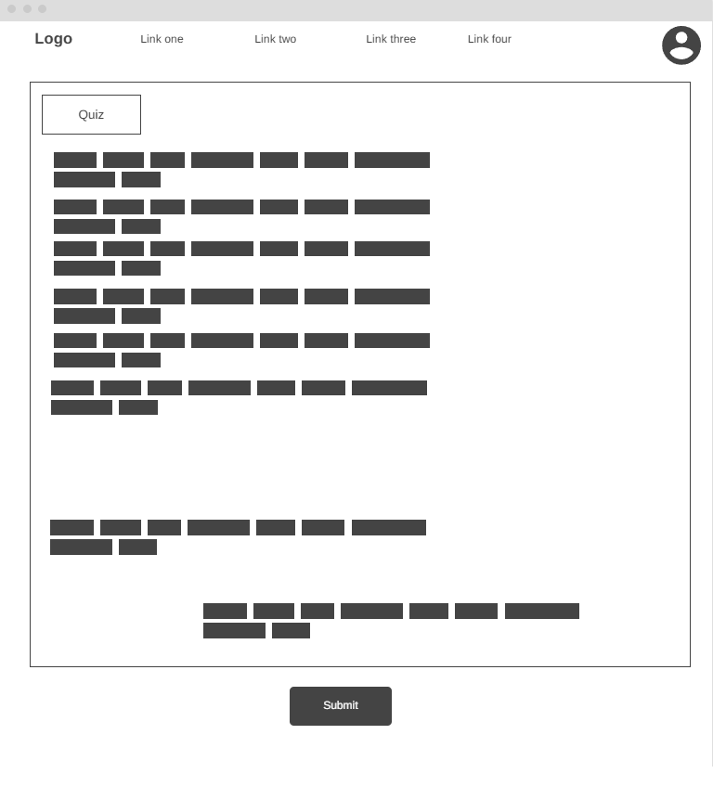

Slide 12

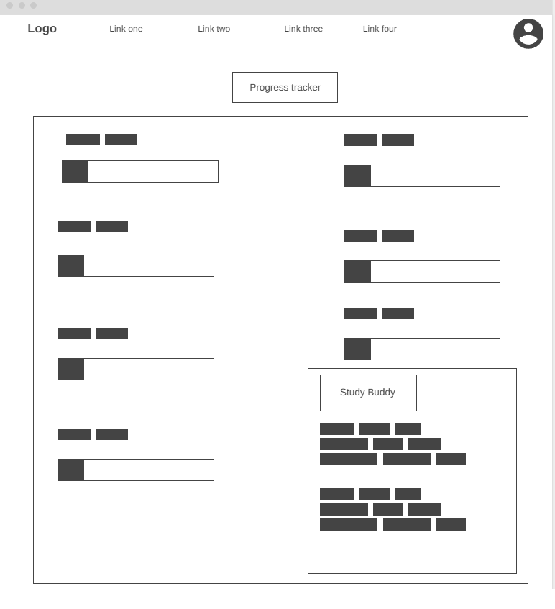

Slide 13
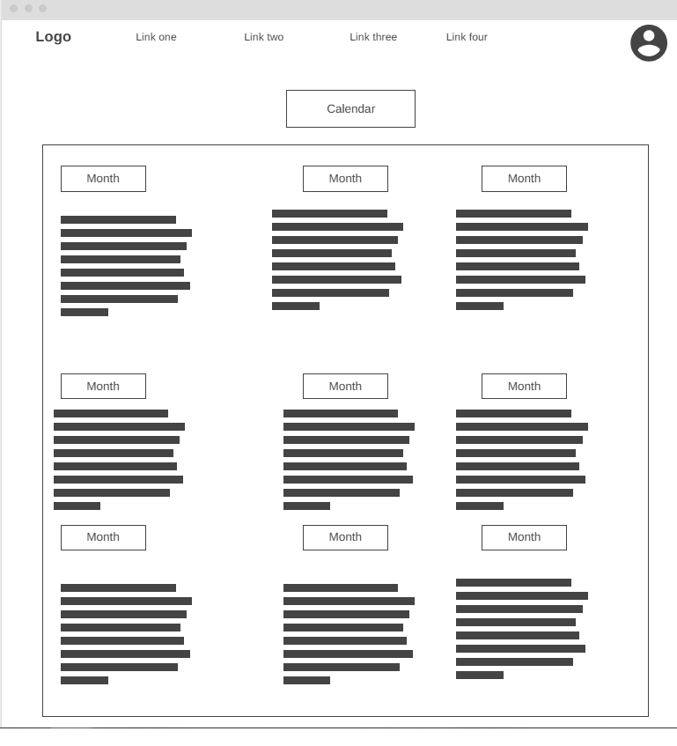

Slide 14
Conclusion
Study Buddy aims to revolutionize education by providing a smart and adaptive learning assistant.
By leveraging AI, students will experience a more engaging and efficient study process.
Future developments will focus on improving accessibility and customization towards the students needs.

Slide 15
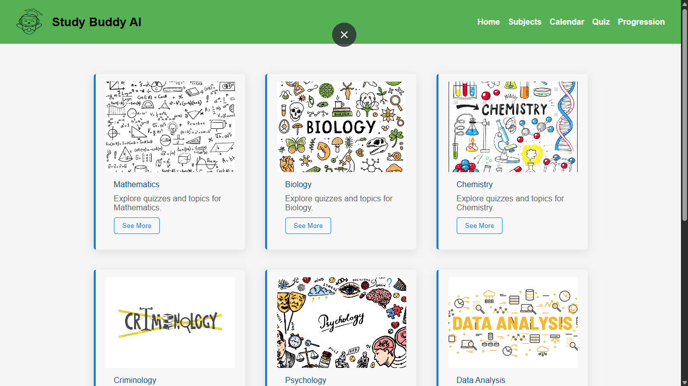
High Fidelity

Slide 16
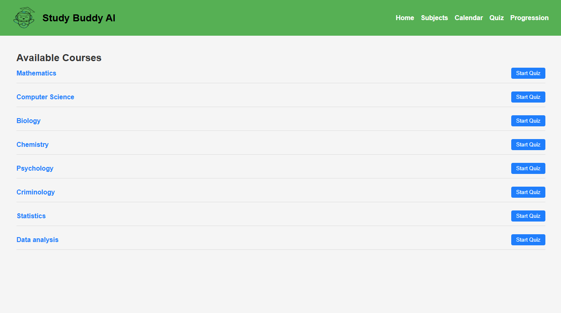

Slide 17
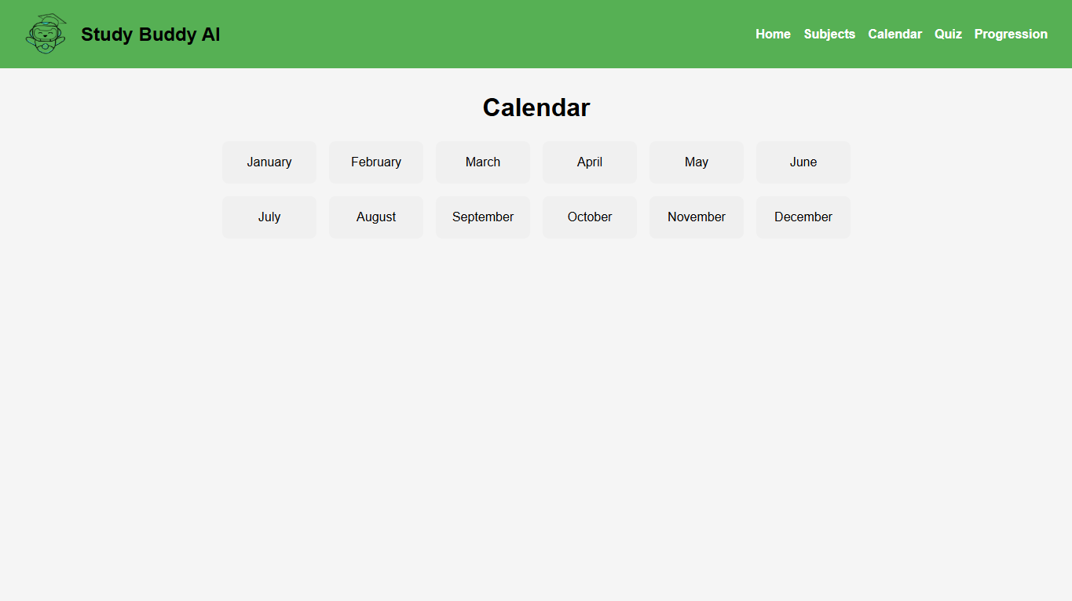

Slide 18
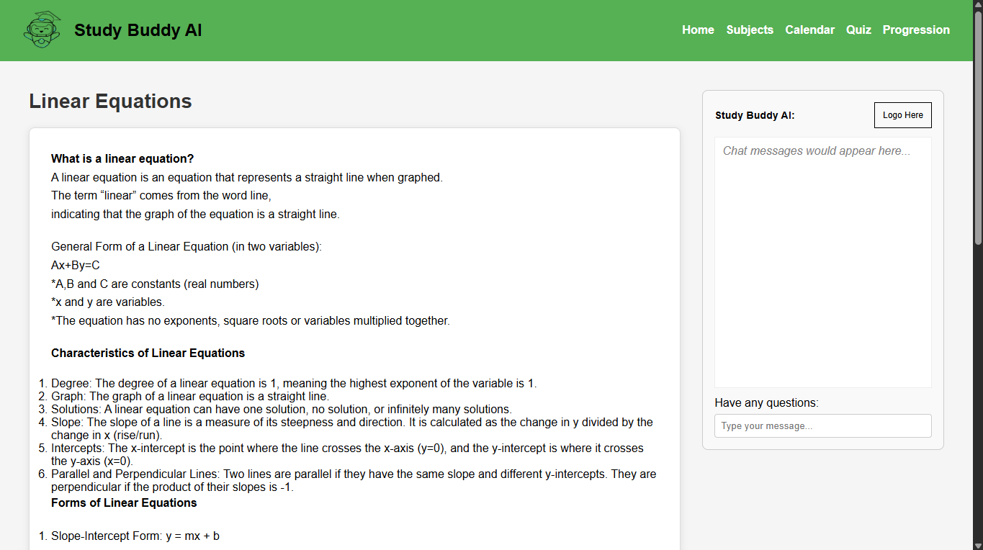

Slide 19
